Slide 1
Developmental Aging: Discovering a New Old Age
Nancy Fox

Slide 2
An Ageist Society
Daily, in America we are witness to, or even unwitting participants in, cruel imagery, jokes, language, and attitudes directed at older people
Even old people are ageist

Slide 3
Declinist View of Aging
Aging is bad
Elderly – a bundle of negative stereotypes about older people
Black balloons on your 40th birthday, coffins on your 50th.
The only GOOD old person is an old person who…

Slide 4
Acts like a young person!

Slide 5
Anti-Aging: A Booming Market
Americans spent >$30 billion on anti-aging products last year
That is expected to rise to $70 billion in the next 30 months
All in an effort to not have wrinkles

Slide 6
Aging “Remedies”
Anti-aging creams don’t work – they have been proven to reduce wrinkle depth by less than 10%
Botox – a diluted form of a deadly toxin – 1 gram could kill 1 million people – temporary and paralyzing
Surest method of wrinkle prevention is…

Slide 7
… Death at an early age

Slide 8
The Declinist’s View
Has led us to create and inhabit a constellation of programs, services, and facilities that attempt to mitigate aging by dealing with decline.
“Long-Term Care” - dreadful hopelessness

Slide 9
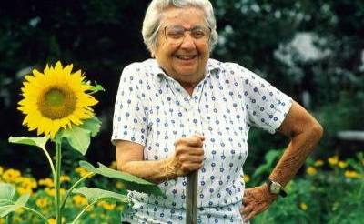
A question for all of us…
What are old people for?

Slide 10
A New View
Developmental Aging
Aging is a continued stage of growth and development
Elders are not less or more than adults
They are different
Just as adults are different from children

Slide 11
Growing & Becoming
“Anyone who stops learning is old, whether this happens at 20 or 80. Anyone who keeps on learning not only remains “young”, but becomes constantly more valuable regardless of physical ability.”
- Harvey Ullman

Slide 12
Developmental Aging
To understand developmental aging and helping our Elders to grow, we must understand about…
DOING & BEING

Slide 13
Doing & Being
Doing = Being in relationship with the material world
I am DOING the dishes.
Being = Being in relationship with non materials things.
BEING in love makes me feel happy.

Slide 14
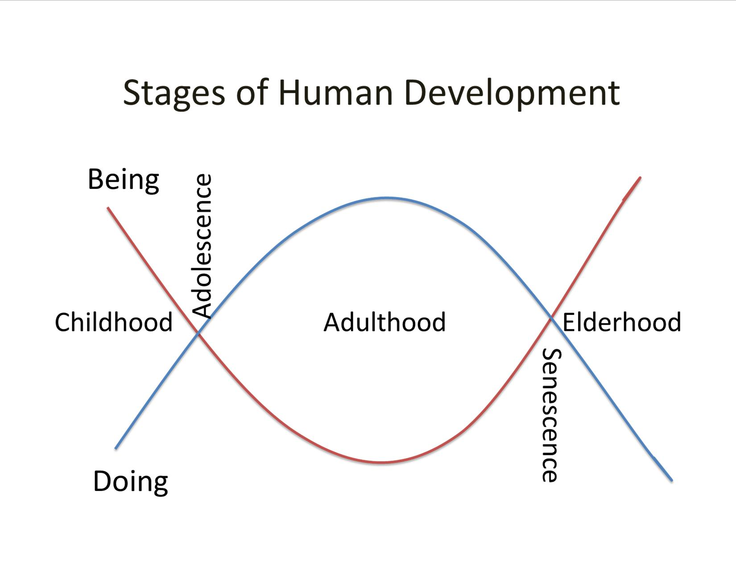

Slide 15
The Cult of Adulthood
Doing, getting & having are the only value
Trampled boundaries – has already destroyed Elderhood – Adult forever
Now encroaching itself into Childhood
The standardization of our lives.

Slide 16
The Cult of Adulthood
Standardized education
Medicating those who don’t fit
16,000 nursing homes
Medicating those who don’t fit
Can go anywhere in this country and find the same stores & restaurants – 7500 chain restaurants – (Cracker Barrel)

Slide 17
Elderhood
Human Elders have their own station and noble purpose
Many other countries and some cultures within the US hold Elderhood as a place of honor and respect.
“When an Elder dies, a library is lost.” – African Proverb

Slide 18
Live Oak Definition of an Elder
An elder is a person
Who is still growing,
Still a learner,
Still with potential and
Whose life continues to have within it
Promise for and connection to the future
An elder is still in pursuit of happiness,
Joy and pleasure
And her or his birthright to these
Remains intact

Slide 19
Live Oak Definition of an Elder
Moreover, an elder is a person
Who deserves respect
And honor
And whose work it is
To synthesize wisdom from long life experience and
Formulate this into a legacy
For future generations

Slide 20
Late Life Developmental Tasks
Peacemaker
Making peace with self, family, & in the world
Wisdom Giver
Story-Telling - how to solve the problems of daily life
Legacy Creator
Of a life lived that can serve others and be handed down to those not yet born

Slide 21
Restoring Elderhood
De-institutionalizing Care
Aging in Community

Slide 22
De-institutionalizing Care
The Total Institution
All aspects of life are conducted in the same place and under the same authority
Each phase of daily activity is carried on in the immediate company of a large batch of others
All phases of the day’s activities are tightly scheduled, one leading into the next, the whole sequence imposed from above by a system of formal ruling and a body of officials
The various enforced activities are brought together into one rational plan purportedly designed to fulfill the official aims of the institution The name of the book?

Slide 23
ASYLUMS

Slide 24
Culture Change
A social movement
Person-centered care
De-institutionalizes care environments & care practices
Mostly it breaks us out of our institutional (Cult of Adulthood) thinking.
Began in Nursing Homes

Slide 25
Even a Person’s Home
Can become an institution if an Elder needs care and:
All of the focus is on DOING, not BEING
All care is focused on the human body and the human spirit is left to wither and die
All decision-making authority is removed from the Elder
The Elder is isolated away from her community & the larger living world
The opportunity to give care is removed

Slide 26
Aging in Community
Vs.
Aging in Place

Slide 27
A New Model for Skilled Nursing
The Green House Model®
Small Houses
Private rooms with Private Baths
Centered around a central hearth area
Open dining and kitchen
Life is not centered around medical treatment

Slide 28
Mirasol Campus - Loveland
Partnering with the Housing Authority of the City of Loveland
Building 6 Green House homes on their independent living campus

Slide 29
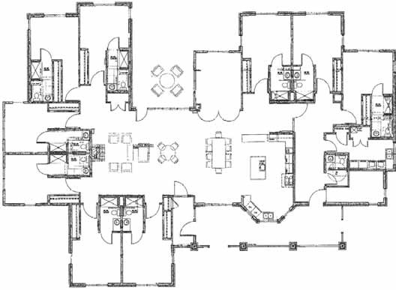

Slide 30
CCCC
Colorado Culture Change Coalition
Not-for-profit organization dedicated to changing the culture of aging and disability by transforming care environment
www.coculturechange.org

Slide 31
The Old People are Coming!

Slide 32
What do you see?
A hoard of locusts?
or
The greatest opportunity our society has had to solve many of our problems?

Slide 33
It’s Up to all of Us
Will we restore Elderhood to its proper place of honor and reap its rewards?
Or will we continue to promulgate the Cult of Adulthood?

Slide 34
Please choose wisely
Nicolas Fox, Future Elder

